Slide 1
Intro to Career Prep
Career Prep Day 1

Slide 2
Class Objectives
By the end of class, you will be able to:
Identify cyber career fields of interest and map out a career path toward a desired role.
Begin developing their professional network
Update your resumes and LinkedIn profiles for the cybersecurity job application process.

Slide 3

In the coming weeks, students will learn and apply job hunting skills that position them to land interviews and job offers.
3

Slide 4

This Week
Over the next two classes, we will cover the following career prep skills that will help you get interviews and land jobs:
01
Finding your cybersecurity career path.
02
Building your cybersecurity network.
03
Non-traditional job searching.
04
Building a powerful resume and LinkedIn profile.
05
Behavioral and technical interview tips.
Notes:
shutterstock_656504470

Slide 5
Cyber Career Paths

Slide 6
Cybersecurity Domains
As we’ve learned throughout this course, there are a vast number of domains that professionals can apply their skills to.
6

Slide 7
Cybersecurity Domains
As we’ve learned throughout this course, there are a vast number of domains that professionals can apply their skills to.
CASB
Federated Identity
Data Protection
Network Design
Secure Application Development
Baseline Configuration
Cloud Security
Security Architecture
Secure System Build
Access Control
Physical Security
Cryptography
COBIT
Identity Management
Security Engineering
Assets Inventory
ISO/IEC
SANS/CSC
Vulnerability Scan
Privileged Access Management
Identity & Access Management
NIST
4th Party Risk
Blueteam
Social Engineering
Certification
Framework and Standard
Training
Conferences
3rd Party Risk
Risk Assessment
Redteam
Application
Career Development
Penetration Test
Source Code Scan
Infrastructure
Peer Groups
Self Study
Data-Centric Risk Assessment
Data-Flow Map
DR
Cybersecurity Domains
Detection
Protection
Blackbox
Whitebox
Industry Specific
Recovery
Governance
Laws and Regulations
Federal
BCP
Prevention
Security Operation
State
Threat Intelligence
Audit
Executive Management Involvement
SIEM
Active Defense
Risk Informed
Vulnerability Management
Data Leakage
User Education
Reports and Scorecards
SOC
Company’s Written Supervisory Procedures (WSPs)
Incident Response
External
Internal
KPIs/KRIs
Breach Notification
Policy
Compliance & Enforcement
Training (new skills)
Contextual
Procedure
Guideline
Containment
Investigation
IOCs
Intel. Sharing
Awareness (reinforcement)
Standard
Eradication
Forensics

Slide 8
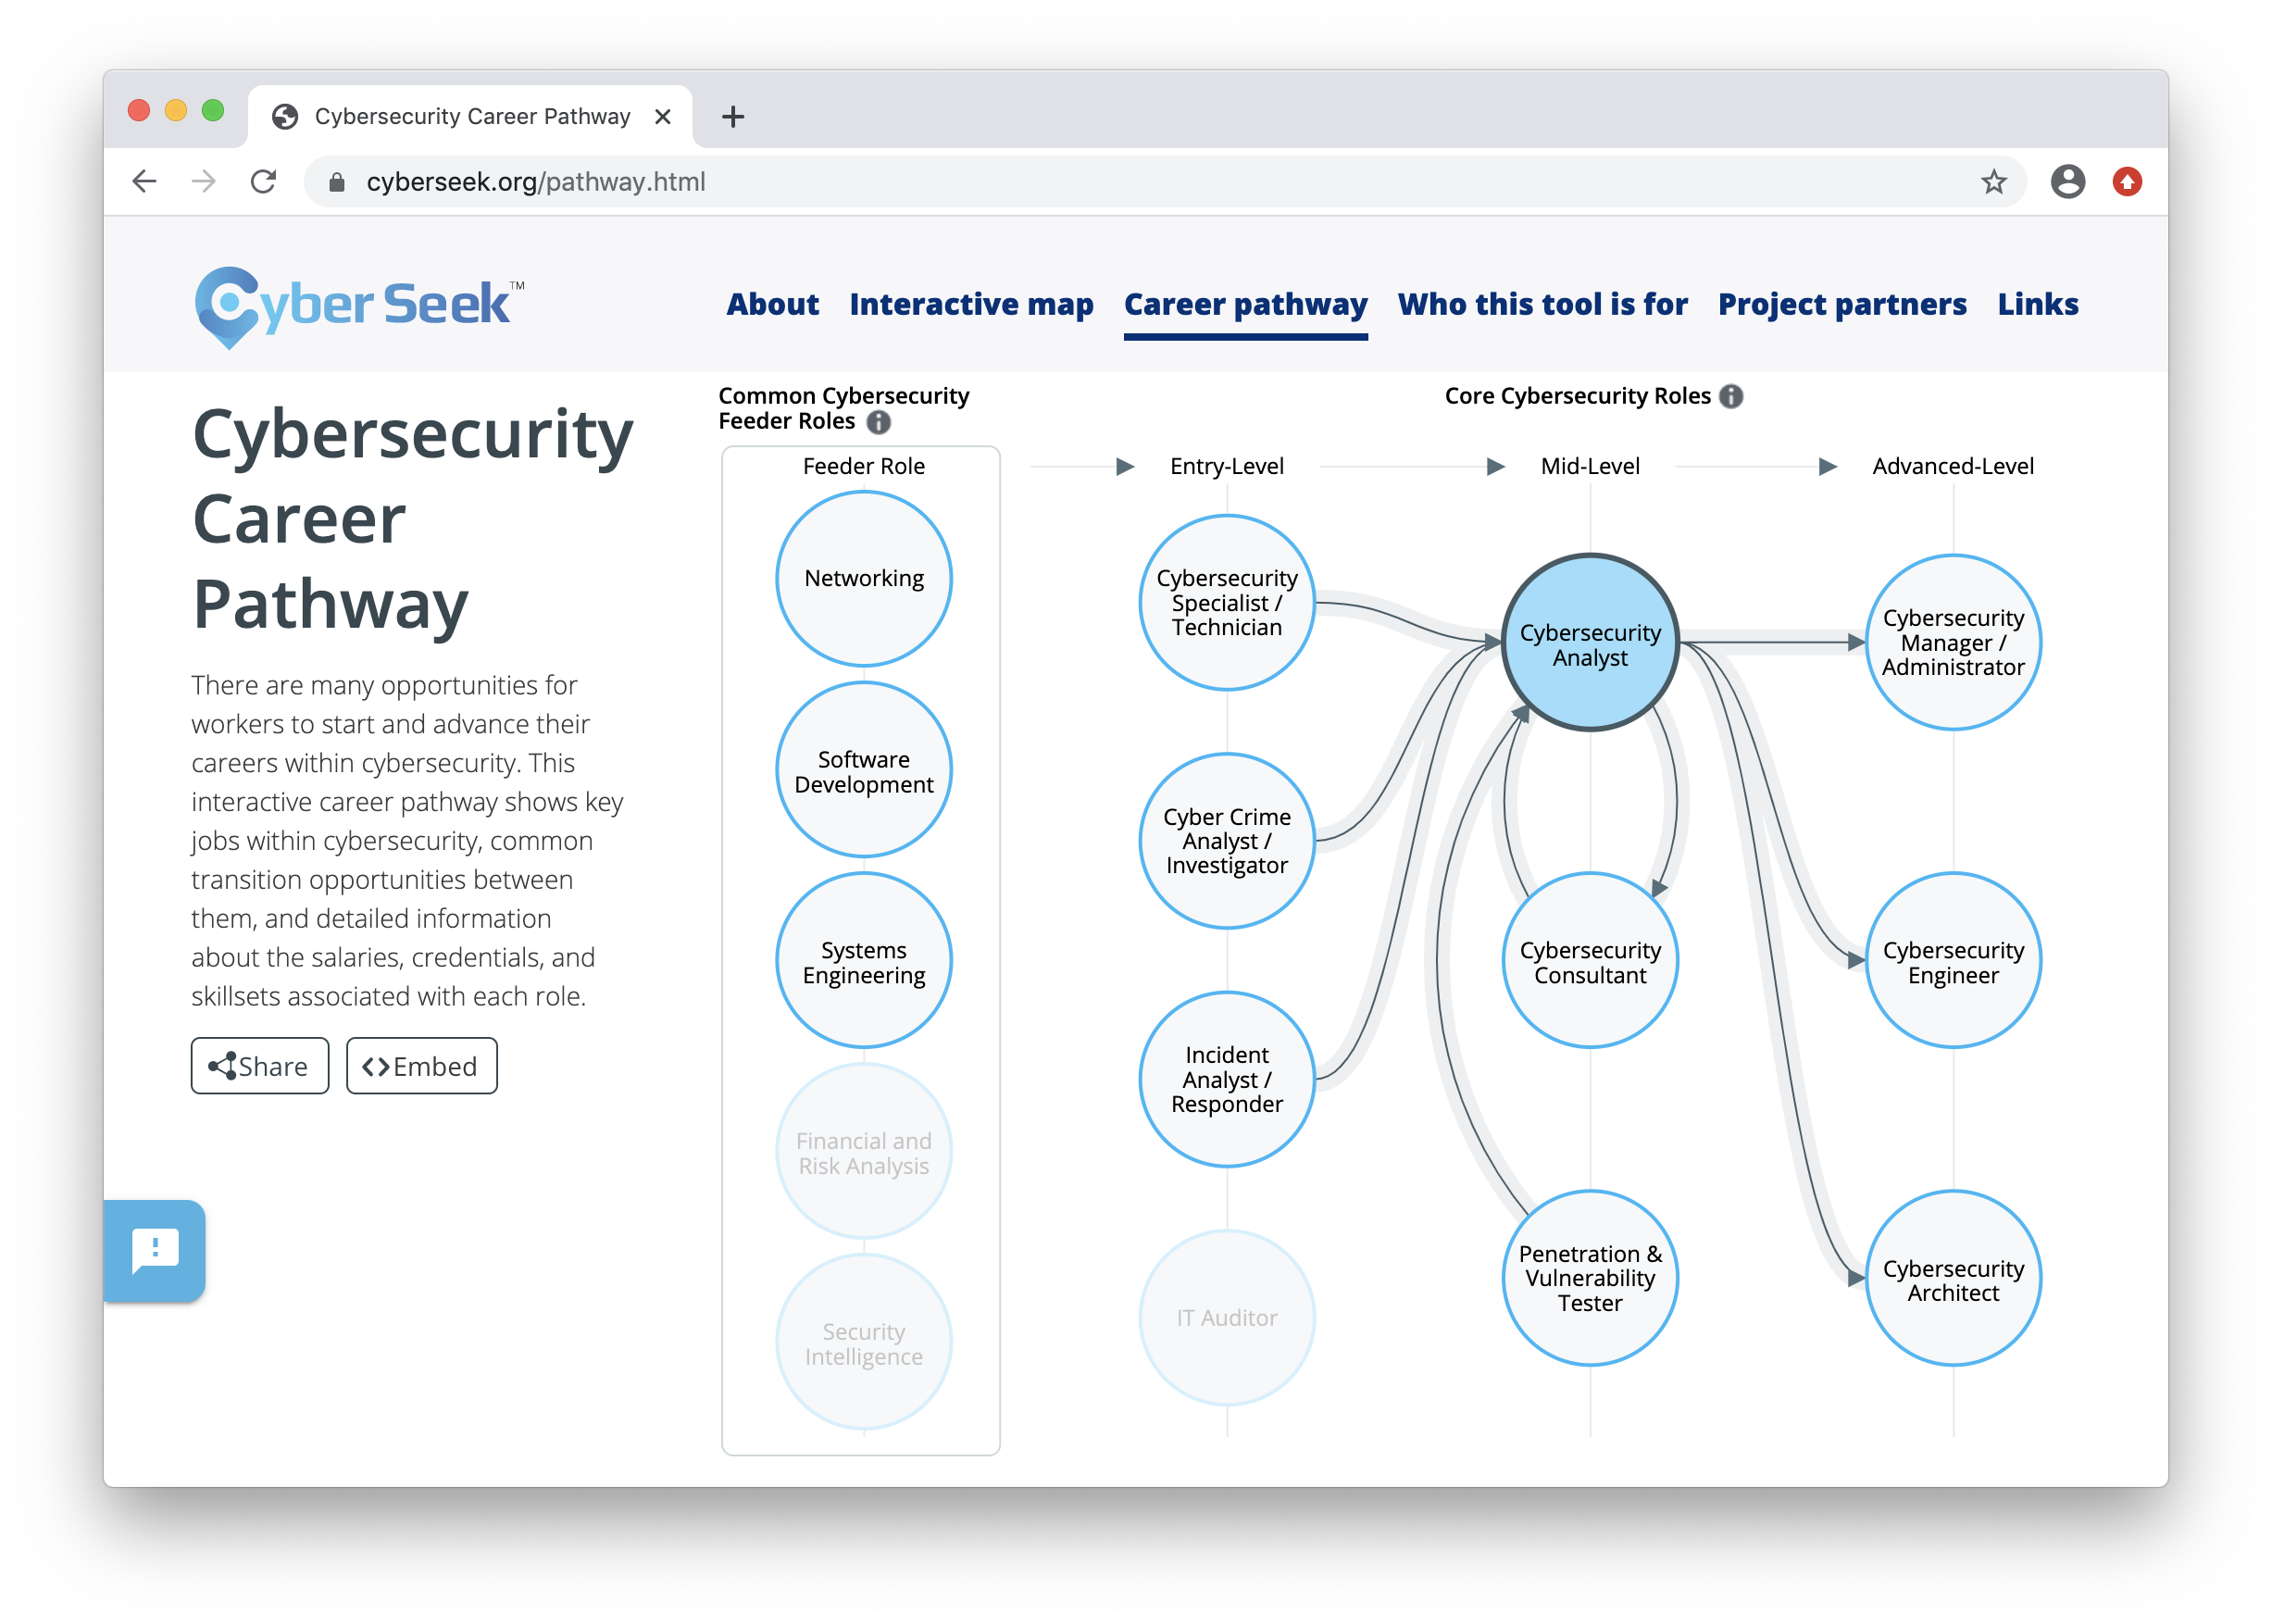
Cyber Career Pathway
The Cyberseek website is a great tool for exploring common career paths.
Clicking on any of the featured roles will display helpful information, such as number of job openings, average salaries, and desired skills and certifications.
(cyberseek.org)

Slide 9
Activity: Career Paths
In this activity, you will use LinkedIn to research career paths of several fellow cybersecurity professionals.
15 Minutes

Slide 11
Cyber Networking

Slide 12

While growing each year, the cybersecurity community is considered a tight-knit, highly connected group of professionals.
12

Slide 13

Cyber Networking
Establishing connections and building your network can help with the following:
01
02
03
Through connections, you can meet other industry professionals, many of whom are actively hiring.
Hiring managers often circumvent the traditional job posting process and hire from personal recommendations.
Networking can provide resources for specific cyber domains.
For example, if you need to find a mobile forensic specialist and have a large network, it's likely that your network contains the specialist you need.
Connecting with professionals who are associated with companies and vendors can give you access to better pricing and personalized service.
For example, a contact who works for a SIEM vendor could come in handy if you are searching for SIEM products for your organization.
Notes:
shutterstock_708582385

Slide 14

Building Your Network
Observe everyone around you: By joining this course, you already have a cyber network consisting of everyone else here.
If you haven’t already, connect with each other on LinkedIn.
Notes:
Image source: shutterstock_1055364239

Slide 15

The best way to build your network is to join local cyber groups, chapters, and professional associations.
15
Notes:
shutterstock_1044198436

Slide 16

Cyber Groups, Chapters and Organization
The benefits of joining these local cyber groups include:
Regional specificity
Welcoming attitude toward new professionals
Monthly meetings, trainings, and social events
Inexpensive or free membership and events
16
Notes:
Image source: shutterstock_1276756537

Slide 17



Specialized Cyber Groups
While many groups are offered for general cyber networking, there are also groups with specialized focuses:
Groups that emphasize certain technologies, such as cloud security groups like Cloud Security Alliance (CSA).
Groups that focus on specific industries, such as banking and finance security groups like Financial Services Information Sharing and Analysis Center (FSISAC).
Groups that connect people from specific demographics, such as the Women in Cyber Security (WiCS).

Slide 18
Activity: Building Your Cyber Network
In this activity, you will start building your cyber network by researching cybersecurity groups and chapters local to your area.
15 Minutes

Slide 20
Job Search Methods

Slide 21

Job Search Methods
While networking is an excellent way to increase your chances of landing an interview, it has to be combined with other job searching approaches.
Notes:
Image source: shutterstock_1500204824

Slide 22




Traditional Job Search Methods
Traditional job search methods include:
01
Searching websites like Indeed, Dice, and Monster.com
02
Searching for open positions on LinkedIn.
03
Working with a recruiter.

Slide 23

Traditional Job Search Methods
The popularity and simplicity of these methods means you are often one of thousands of applicants
The person reviewing the job applications will only know you by the information on your resume or job profile.
Notes:
shutterstock_651788878

Slide 24

Non-Traditional Job Search Methods
01
Propose that an employer create a position for your skills.
You can mention what you observe to be the organization's challenges or areas of need, and how your skills can address them.
This can even be done at the organization where you currently work.
Notes:
shutterstock_1444078949

Slide 25

Non-Traditional Job Search Methods
02
Share your skills on platforms other than LinkedIn and your resume.
Create blogs, custom websites, and videos to advertise your skills and find potential employers.
Notes:
shutterstock_404189200

Slide 26
Non-Traditional Search Methods
Jane Doe
123 Anywhere Ave, Everywhereville MN 00101 | 123-456-7890 | jdoe@2u.com
03
Reach out to the decision makers.
Recruiters and talent acquisition staff often manage an organization’s hiring process. But they are the gatekeepers, not the ones who make the final hiring decision.
Hello,
I’m an aspiring cybersecurity professional transitioning from a career in {previous career}. As I make this transition and map out my job aspirations and pathways, I came across your position and thought you would be a great person to reach out to for some advice.
I recently graduated {or about to graduate} from the Cyber Security Bootcamp at {University}, where I studied Offensive & Defensive security, web application security, and governance & compliance. I am also currently working {or worked} on some exciting new projects, including {project description}.
I would love to link up and pick your brain about how you got started, what you do at {company they work at}, and how you maintain your expertise. Let me know if you’re available to grab some coffee or set up a quick phone or Zoom call sometime. Looking forward to hearing from you soon!

Slide 27
Finding a Decision Maker

Slide 28
Activity: Hacking Your Job Search
In this activity, you will “hack” your job search by applying non-traditional job search methods.
15 Minutes

Slide 30


Slide 31
Resumes and LinkedIn

Slide 32

The Importance of Resumes and LinkedIn
In today’s cybersecurity job market, it is typically a requirement for all candidates to have a resume and a LinkedIn profile.
Notes:
Image Source: shutterstock_717374116

Slide 33

Resumes 101
A resume is a company's first impression of you.
You should think of a resume as an opportunity to professionally show off your work experience, education, technical skills, and career accomplishments.
While having a superior resume can increase your odds of landing an interview, having an inferior resume can quickly eliminate you from consideration, even if you are qualified for a position.
Notes:
Image Source: shutterstock_717374116

Slide 34

Resumes 101
One page in length.
Keep resumes concise by including only relevant information.
If applicable, only include the past 10 years of employment.
Professional in tone.
Resumes are made professional by maintaining grammatical accuracy, making sure all information provided is correct, and using appropriate word choice.
Resumes should be:
Aesthetically pleasing.
Make sure bullet points align, font types, colors, and sizes are consistent, and the content is easily digestible.
Notes:
shutterstock_1131584312

Slide 35

Resume 101
Resumes should following this order:
01
Your name and contact information
02
Summary statement
03
Technical skills
04
Recent work experience
05
Educational background
Notes:
shutterstock_1505694836

Slide 36


Name and Contact Information
While this section is usually straightforward, consider the following:
Use the same name that appears on your LinkedIn. Do not use a nickname.
Do not list a home address.
Add your phone number and email.
Consider using a professional, security-based email provider such as ProtonMail.

Slide 37
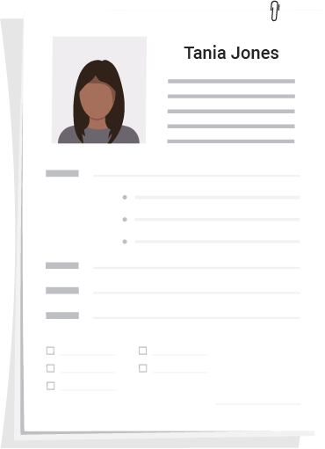
Summary Statement
Summary statements are placed at the top of a resume to give the employer a preview of the candidate’s expertise and personal motivations.
DEmonstrate your passion, professional interest, value, and accomplishments.
Should be a short paragraph. Do not include more than four to five sentences.
When faced with thousands of resumes, recruiters may only read personal statements before deciding to continue reading or move on to the next candidate.
Be sure to make an impact by speaking directly and personally!
Notes:
shutterstock_1513723706

Slide 38
Technical Skills
For cybersecurity job seekers, the technical skills section can be considered the most important of a resume.
Companies use algorithms to search through resumes for matching keywords
Having the correct skills to match these keyword searches can greatly impact the success of your resume.
Notes:
shutterstock_1513723706

Slide 39
Technical Skills
Including strong keywords and skills to catch the attention of recruiters and algorithms is a process is known as “optimizing your resume.”
Keep it simple, clear, and concise.
Notes:
shutterstock_1513723706

Slide 40
What have we learned so far?
Keep track of all the topics, tools and skills you’ve learned while it is still fresh in your memory.
Also include non-technical skills like communications and reporting.
40

Slide 41
Recent Work Experience
This section contains your most recent and relevant work experience.
Each role should include:
Job Title, Employer, Start and End Date, Location (optional)
If you’re still employed, enter “Present” instead of end date.
Job Responsibilities:
Bullet points that emphasize hard skills, responsibilities, and quantifiable achievements during employment.
Notes:
shutterstock_1513723706

Slide 42
Recent Work Experience
Some important notes:
For past jobs:
Use simple past tense: managed, organized, operated.
Each responsibility or description should begin with an action word.
For your current job:
Use simple present tense: manage, organize, operate.
Unless your experience is limited, do not include experience unrelated to the role you’re applying to.
Notes:
shutterstock_1513723706

Slide 43

Recent Work Experience
When writing strong bullet points:
Think about the specific results of your work.
Include quantitative information to support your results when applicable.
Be as specific as possible, especially with numerical data.
Notes:
shutterstock_1568981656

Slide 44

Work Experience
Consider the following when writing about past experience. Have you:
Improved or created a process or product that led to increased productivity or the success of a project?
Achieved something tangible with limited resources or time?
Managed or led a team, or brought together a diverse group of people to achieve a goal?
Presented complex information clearly to relevant stakeholders?
Received awards, a promotion, or positive reviews because of your work?
Notes:
shutterstock_1304853175

Slide 45



Work Experience
Consider the following descriptions that insufficiently describe a task or role:
Barista
Teacher
Graphic Designer
21.0%
12.0%
Made drinks for Starbucks customers during rush hours.
Made lesson plans.
Created award-winning logo.
14.0%
Notes:
Shutterstock_678153823 shutterstock_309239105 shutterstock_168159773

Slide 46
Work Experience
Quantitative measurements and strong action verbs improve the descriptions.
Barista
Teacher
Graphic Designer
21.0%
12.0%
Made drinks for Starbucks customers during rush hours.
Made lesson plans.
Created award-winning logo.
Increased Starbucks’ rush hour sales by 14% over six months using suggestive up-selling strategies.
Designed and taught year-long curriculum for English Language Arts for students in grades 7–12.
Won an American Graphic Design Award from Graphic Design USA for Mudd Valley logo that was featured in Graphic Design USA December 2015 issue.
14.0%
Notes:
Shutterstock_678153823 shutterstock_309239105 shutterstock_168159773

Slide 47
Educational Background
Educational background section should include the following:
This cybersecurity program and the city and state.
Include relevant coursework, tools, and projects.
College or university.
Any degrees obtained.
If you completed some coursework but didn’t finish the degree, write: “Coursework completed toward a BA in Neuroscience.”
Include GPA if above 3.3 and grad year if within 10 years.
Notes:
shutterstock_1513723706

Slide 48
Activity: Crafting Your Resume
In this activity, you will update your resume summary and experience with the best practices you just learned.
15 Minutes

Slide 50
LinkedIn

Slide 51

LinkedIn
Like your resume, your LinkedIn profile is a platform to demonstrate your work history, skills, certifications, and achievements.
LinkedIn also allows you to build your network of colleagues and share recommendations and endorsements.

Slide 52
LinkedIn 101
A LinkedIn profile should include:
01
Picture
02
Headline
03
Summary
04
Work experience
05
Education, certifications, and skills
06
Recommendations and endorsements from co-workers and network

Slide 53
LinkedIn
Picture
Avoid anything distracting in the background.
Avoid photos where you are doing activities.
Minimum resolution of 72 DPI, minimum 400x400 pixel size, and no larger than 8 MB.
Headline
Will be displayed when you post on a feed or apply to jobs.
LinkedIn algorithms use headlines to find individuals in searches.
Placing specific keywords in the headline can help optimize your profile.
Summary
Similar to your resume statement, your LinkedIn summary should demonstrate your passion and key skills that reflect the position you are searching for.

Slide 54
LinkedIn
Work Experience
Roles should match what’s stated on resume.
Use common titles that match the industry you are entering, so you appear in search results.
SEM Ninja → Search Engine Marketing (SEM) Analyst
Education and Certifications
Content should reflect resume.
Add all higher education and certifications.
Add the Credential ID for certifications where applicable.
Skills
The skills section is searched by recruiter search tools.
Research the exact skills and their phrasing in job descriptions on LinkedIn and from organizations you’re interested in.

Slide 55
Ask coworkers and classmates to endorse you and return the favor by endorsing them.
55

Slide 56
Activity: Crafting Your LinkedIn
In this activity, you will update your headline and summary, and craft a custom URL.
15 Minutes

